Slide 1
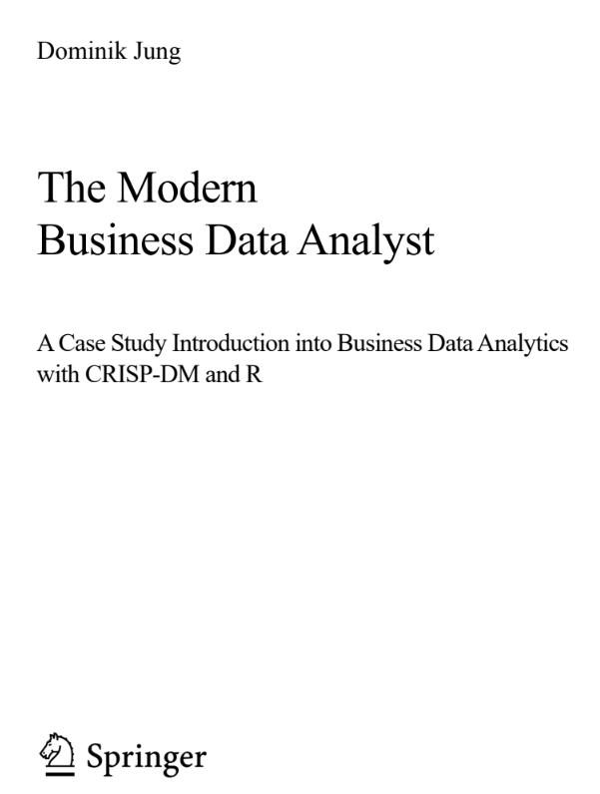
Business Data Analytics Powerpoint slides to support you during your business data analytics projects
Dr. Dominik Jung
dominik.jung@junglivet.com
Further materials (↗Link)

Slide 2
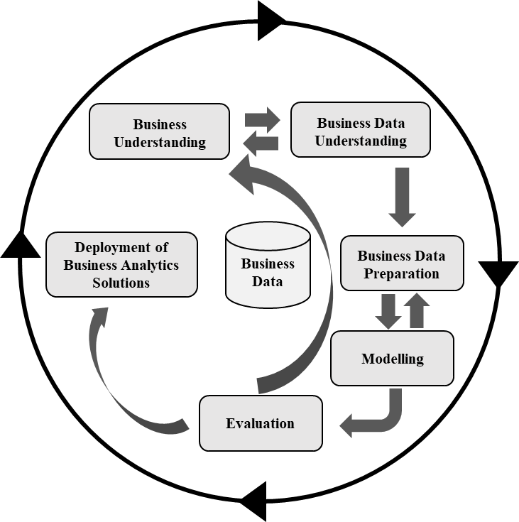
Objective for today: Business Understanding Understand the project objectives, define business problems and preliminary plan to achieve the objectives
Business Understanding
Determine business objectives
Record the information that is known about the organization’s business situation at the beginning of the project.
Assess situation
Fact-finding about all of the resources, constraints, assumptions and other factors.
Determine business data analytic goals
Describe the intended outputs and success criteria of the project that enables the achievement of the business objectives.
Produce project plan
Sketch project plan for achieving the business data analytic goals and thereby achieving the business goals.

Slide 3

Business background: Synch of ideas and expectations Let's set out your personal expectations of the project in advance
What do we want to find out in the end? What is our objective? Who are our clients?
Let's take turns to briefly note down the expectations, please.
Expectation
Customer
tbd
tbd

Slide 4
Determine business objectives and success criteria Record the information that is known about the organization’s business situation.
Describe your primary objective, from a business perspective and the criteria for a successful or useful outcome to the project.
Business objectives and success criteria
tbd

Slide 5
Inventory of resources Identify resources, constraints, assumptions and other factors that should be considered
List the resources available to the project
Type | Resources
Personell | tbd | tbd
Data | tbd | tbd
Computing | tbd | tbd
Software | tbd | tbd
Budget | tbd | tbd
Other | tbd | tbd

Slide 6
Requirements, assumptions and constraints Identify resources, constraints, assumptions and other factors that should be considered
Are there any relevant requirements, assumptions and constraints?
Please name related risks or events that might delay the project or cause it to fail
Requirements, assumptions, and constraints
Risks
tbd
tbd

Slide 7
Costs and benefits Cost-benefit analysis for the project, compare the costs of the project with the potential benefits to the business
Compare aggregate costs and benefits and compute return on investment (estimate)
 | Objective (100%) | Objective (90%) | Objective (80%)
Total Costs | -
Benefits | +
Benefit-cost ratio

Slide 8
Determine business analytics objectives and success criteria Describe the intended outputs of the project and criteria from a technical perspective
Describe your primary objective, from a technical /business analytics perspective and the criteria for a successful or useful outcome to the project
Business objectives
Analytics objectives and success criteria
tbd
tbd

Slide 9
Produce project plan Describe the intended plan for achieving the business analytics goals
Describe the intended plan for achieving the data mining goals and thereby achieving the business goals.
tbd

Slide 10
Define potential team members, tools and techniques Initial assessment of a potential team providing tools and techniques that should be performed
What could a project team look like? Who do we need for it and what should be the skillset?
Role | Techniques and Skills | Tool | Person
Data Scientist | System design and deployment | R, RShiny | tbd
Which existing internal / external teams could we use?
tbd

Slide 11
Management One-Pager
01
Description of the use case: cost estimation
04
Data Sources
Problem definition
Goal
Deskription of proposed solution
Results
What data is used and what is the quality?
tbd
02
Benefits
03
Challenges
05
Evaluation
What are the benefits?
Monetary
Time effort gains
Non Tangible
What might jeopardize the success
Data availability
Political issues
How to measure success?
Project team
Possible team members
Vision
Define Vision / Purpose / Objective

Slide 12
Outlook and next steps
What are our next steps? How do we proceed?
Let's determine the next steps together!
Who will | Do what | By when?

Slide 13
Objective for today: Business Data Understanding Understand the project-related data sources, describe and explore data and validate the data quality
Business Data Understanding
Collect Initial Data
Generate initial data report based on collected data.
Describe Data
Generate data catalogue or data description report.
Explorative Data Analysis (EDA)
Explore data and generate data exploration report.
Verify Data Quality
Report findings and steps in form of a short data quality report.

Slide 14
Initial data - overview Acquire the data (or access to the data) listed in the project resources
List the initial data and sources available to the project
Data | Sources |  | Extraction
Production data | Production history | Supply database | Mr Smith (method: data dump)

Slide 15
Findings data extraction Recorded problems encountered and any resolutions achieved
Findings and open questions based on problems encountered during data collection
tbd

Slide 16
Dataset <name> Preview
Notes
EXAMPLE

Slide 17
Describe data Examine the “gross” or “surface” properties of the acquired data and report on the results
Describe the data that has been acquired, including the format of the data, the quantity of data (for example, the number of records and fields in each table), the identities of the fields, and any other surface features which have been discovered. Evaluate whether the data acquired satisfies the relevant requirements.

Slide 18
Findings from EDA Report findings from the explorative data analysis using querying, visualization, and reporting techniques
EXAMPLE

Slide 19
Objective for today: Business Understanding Understand the project objectives, define business problems and preliminary plan to achieve the objectives
Business Data Preparation
Select data
Decide on the data to be used for analysis
Clean data
Raise the data quality to the level required by the selected analysis techniques.
Construct data
Constructive data preparation operations such as the production of derived attributes or entire new records, or transformed values for existing attributes
Integrate data
methods whereby information is combined from multiple tables or records to create new records or values.
Format data
Formatting transformations refer to primarily syntactic modifications made to the data that do not change its meaning, but might be required by the modeling tool

Slide 20
Select data Decide on the data to be used for analysis
Based on the data understanding, which data should be used in the following steps?
Dataset | Description | Criteria 1 | Criteria 2 | Inclusion
Production_log | Production history of the productionhall 1 in Upper Twerting | high | middle | Yes

Slide 21
Data Cleaning Report Overview of the most relevant steps to clean the different datasets
tbd

Slide 22
Data and feature construction report Overview of the most relevant steps to create new data (observations and features)
tbd

Slide 23
Final Dataset <name> Preview
Notes
EXAMPLE

Slide 24
Objective for today: Modelling Describe the modelling process and results
Modelling
Select modellig techniques
Select the actual modeling technique that is to be used.
Generate test design
Generate a procedure or mechanism to test the model’s quality and validity.
Build model
With any modeling tool, there are often a large number of parameters that can be adjusted. List the parameters and their chosen values, along with the rationale for the choice of parameter settings.
Asses model
Rank the models, asses the models according o the evaluation criteria

Slide 25
Overview model performance Overview of the most models and performance indicators (e.g. accuracy, precision, recall etc.)

Slide 26
Objective for today: Evaluation Assess the degree to which the model meets the business objectives and decide the next steps
Evaluation
Evaluate results
Previous evaluation steps dealt with factors such as the accuracy and generality of the model. This step assesses the degree to which the model meets the business objectives.
Review process
Summarize the process review and highlight activities that have been missed and those that should be repeated.
Determine next steps
List the potential further actions, along with the reasons for and against each option.

Slide 27
Mockups
Button
Textinput
USER STORY
<Beschreibung>
Select box
Checkbox

Slide 28
Possible next steps Overview of possible relevant steps or actions
OPTION 1
tbd
Use colors to indicate business value, project costs or feasability and describe step here
OPTION 2
tbd
Use colors to indicate business value, project costs or feasability and describe step here
OPTION 3
tbd
Use colors to indicate business value, project costs or feasability and describe step here

Slide 29
Outlook and next steps
What are our next steps? How do we proceed?
Let's determine the next steps together!
Who will | Do what | By when?

Slide 30
Objective for today: Deployment Provide the findings of your project in form of a business data analytics solution to your customers
Deployment
Plan deployment
Determine in which form the results should be implemented and define a strategy for deployment.
Plan monitoring and maintenance
Summarize the monitoring and maintenance strategy, including the necessary steps and how to perform them
Produce final report
Summarize findings and results of the project (used for management)
Review project
Assess what went right and what went wrong, what was done well and what needs to be improved (only used internal and not for management)

Slide 31
Outlook and next steps
What are our next steps? How do we proceed?
Let's determine the next steps together!
Who will | Do what | By when?

